Slide 1
Shadow, Time and Location
Jayesh Kawli
Ezhilan Ilangovan

Slide 2
Presentation Agenda
Why this project?
How did we go about?
What did we create?

Slide 3
Motivation
Shadows
Importance in image
Useful and troublesome
Detection is challenging
Applications

Slide 4
Project Aim
Implement shadow detection
Deduce time from a gnomon
Detect latitude from artificial images

Slide 5
Shadow Detection Algorithms
Intensity Statistics
Average of intensities
Works well on outdoors
Image Differences
Intensity matching
Works on images with shadow and object
Intensity difference between images taken at two intensity settings
Images can be translated if needed
Works on shadow only images
Threshold selection is crucial
Accuracy depends upon pixel to pixel mapping

Slide 6
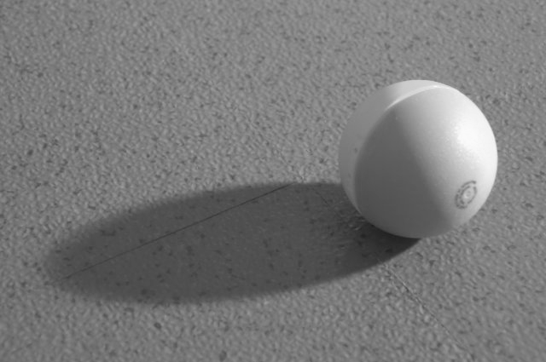
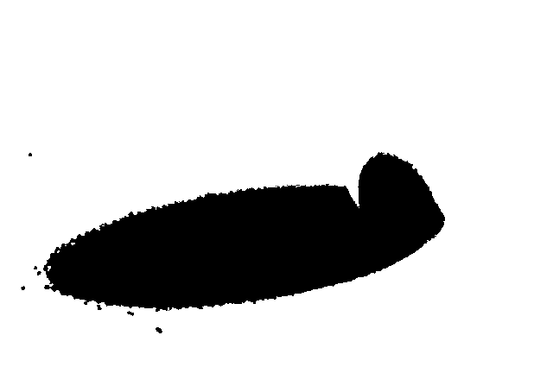
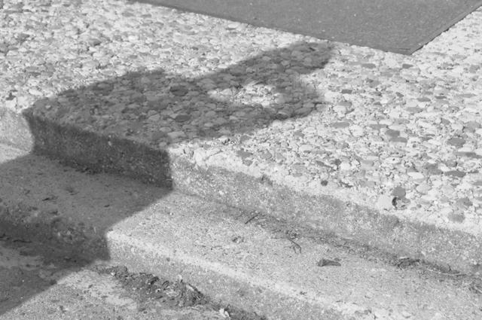
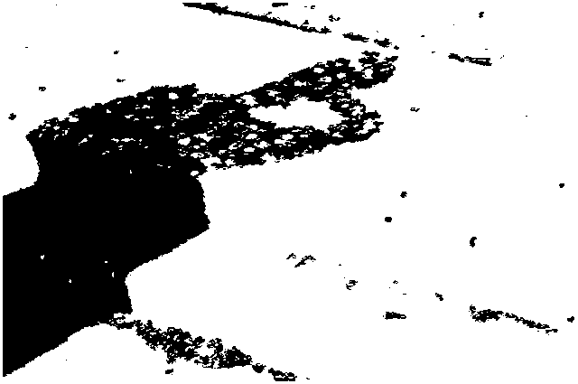
Intensity Statistics

Slide 7
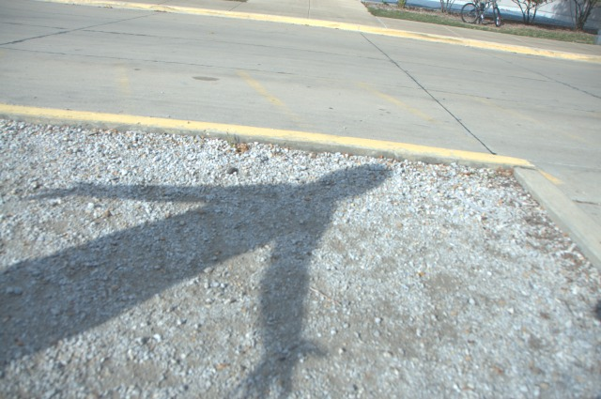
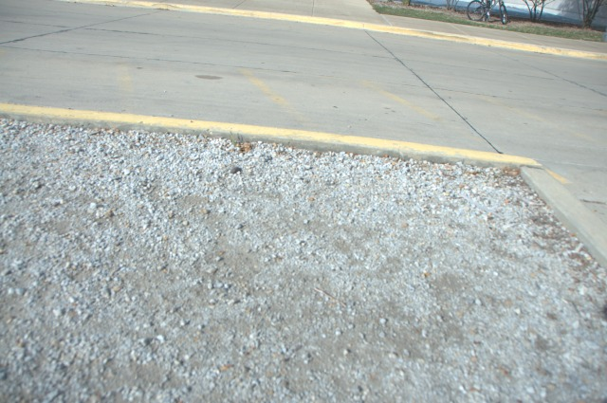
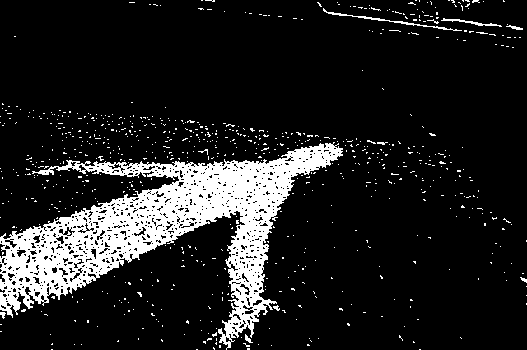
Image Differences

Slide 8
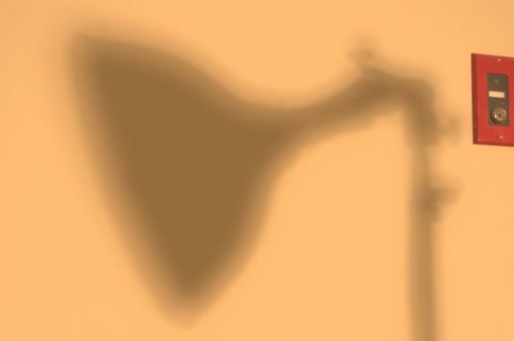


Image Differences (Contd.)

Slide 9
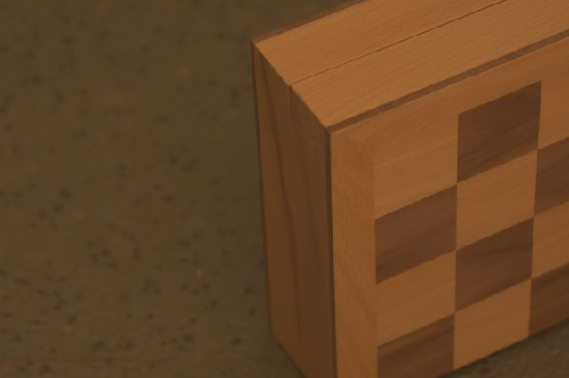
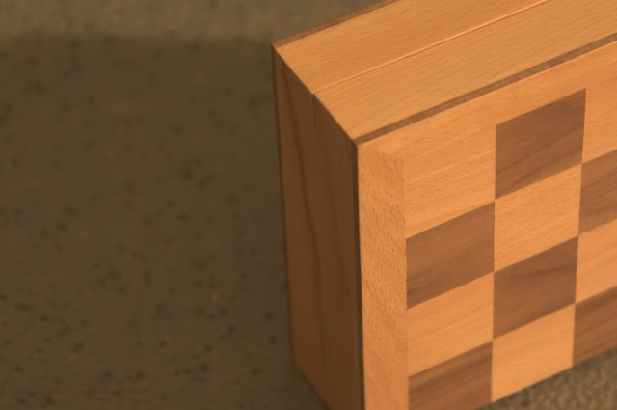
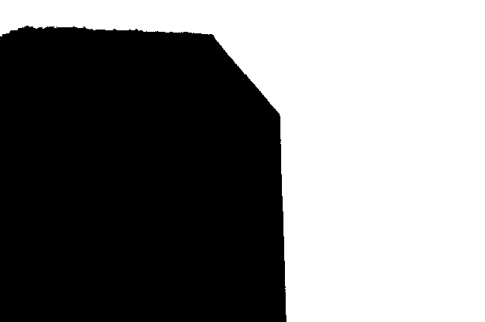
Intensity Matching

Slide 10
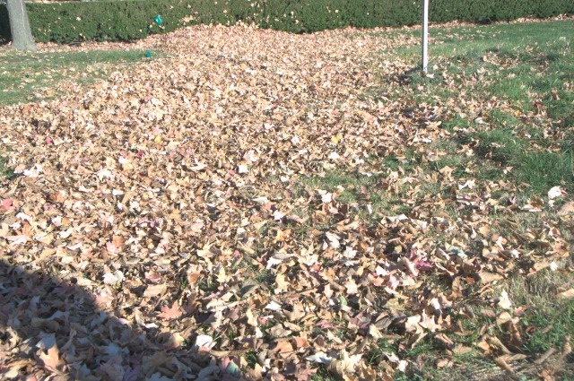
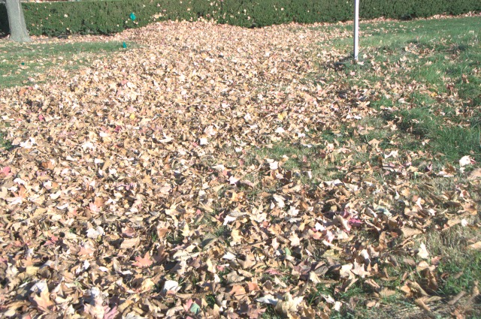
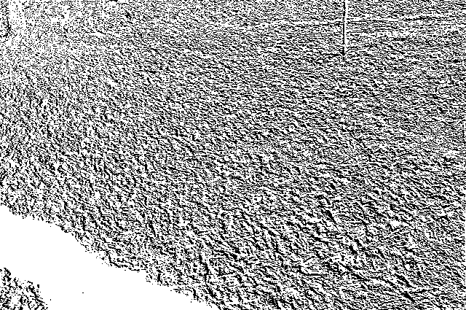

Intensity Matching

Slide 11
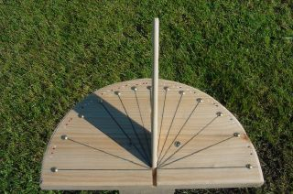
A Gnomon
Accurate in detecting time
Made a gnomon for Bloomington
Horizontal angle = 39.26 degrees (latitude of blm)

Slide 12
A Gnomon (Contd.)
Detected shadow using intensity statistics
Detected the shadow edge
Determined the direction of sun
Detected shadow orientation
Used formula to detect time

Slide 13
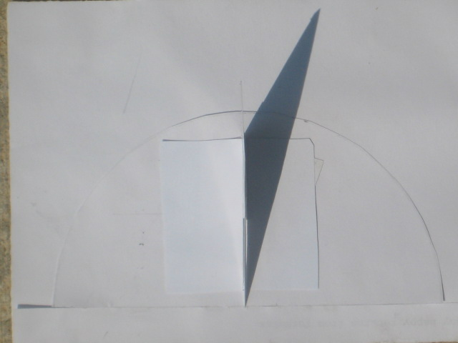
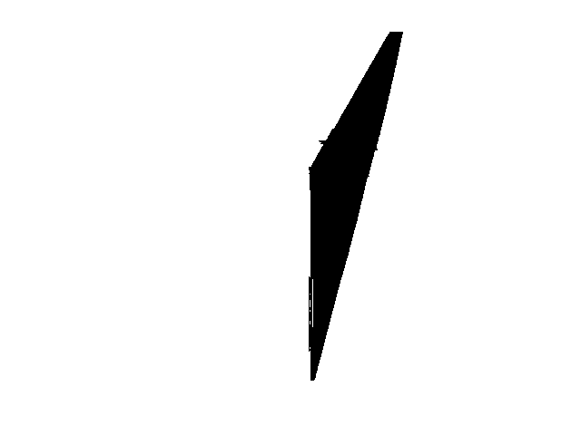
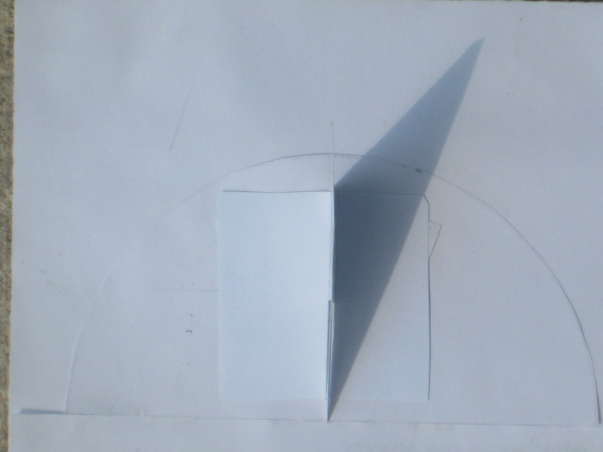

Time From Gnomon

Slide 14


Time From Gnomon (Contd.)
Actual Time | Detected Time
10:14 | 10:36
Actual Time | Detected Time
15.42 | 15.42

Slide 15
Latitude Detection
Experiment requires a simple object of known length
Detected shadow of the simple object
Calculated sun’s elevation from shadow length
Detected the latitude of the location using a formula

Slide 16


Latitude Detection (Contd.)
Object length = 250 px
Sun elevation = 65 degrees
Latitude = 40 degrees
Shadow length = 121 px

Slide 17
Demo
Shadow detection in natural images
Shadow detection in Gnomon
Detecting time from Gnomon

Slide 18
Overall View
Geo-locator
Detect latitude and longitude
Location
Projective transformation
Detect Sun’s elevation
Shadow detection confidence

Slide 19
Future work
Change the algorithm for natural images
Make shadow detection more robust
Extending current work to location detection in a large scale

Slide 20
Thanks

